Slide 1


The Relevance
of Sediment Regime
for River Ecosystems
Ellen Wohl
Department of Geosciences
Colorado State University
Notes:
25 minutes

Slide 2
Outline
What is a sediment regime?
How do people alter sediment regimes?
What are the consequences of
altered sediment regimes?
How can a balanced sediment regime be designed?

Slide 3
I. What is a sediment regime?
Sediment regime includes inputs and outputs of mobile sediment from a length of channel & storage of sediment within the channel and floodplain over a specified time interval.
upstream inputs
suspended load
bed load
storage
floodplain
bed
banks
bars
lateral inputs
uplands
tributary
floodplain
banks
lateral outputs
floodplain
banks
downstream outputs
suspended load
bed load

Slide 4
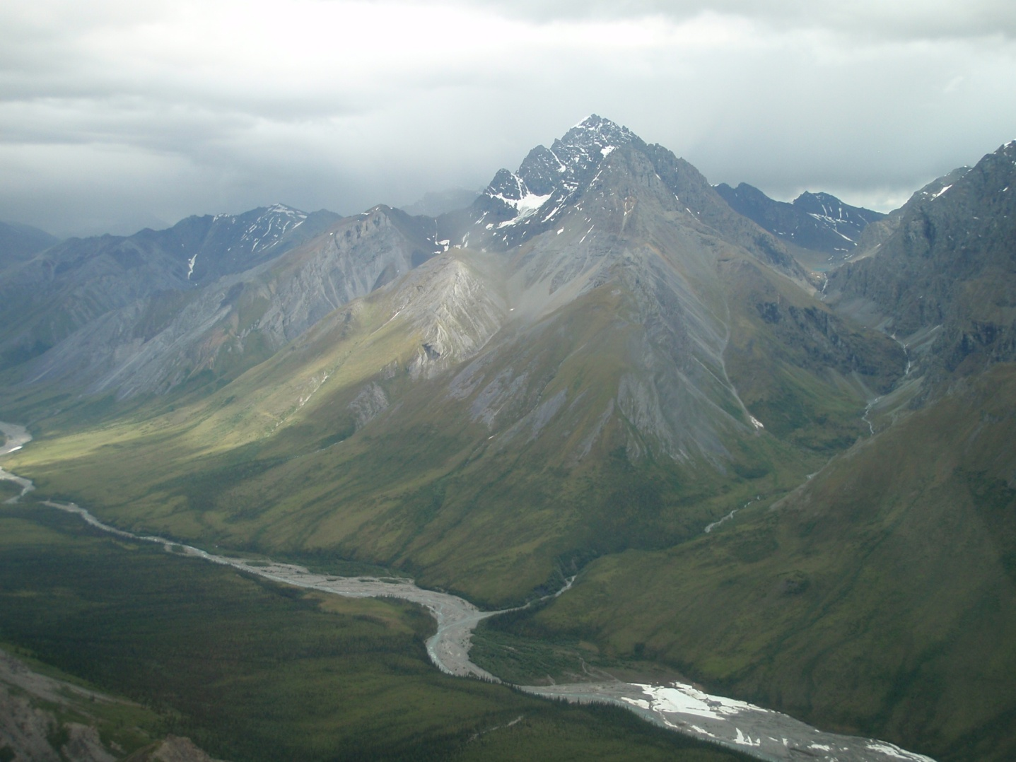
Two-part conceptual framework for understanding sediment regimes:
Sediment budget
Water & sediment interactions in a valley context

Slide 5
Sediment Budget
ΔS = Inputs – Outputs + Storage
ΔS = (I_{us} + I_{lat}) – (O_{lat} + O_{ds}) + S
Basin Scale
(10¹-10⁶ km² & 10²-10⁶ years)
(climate, geology, land use)
Reach Scale
(10⁰-10³ m² & 10⁰-10² years)
(valley geometry, position in basin,
flow regime, river engineering)

Slide 6
A natural sediment regime is characterized by variations across space & through time.
Mississippi River: space
Sediment discharge
Water discharge

Slide 7
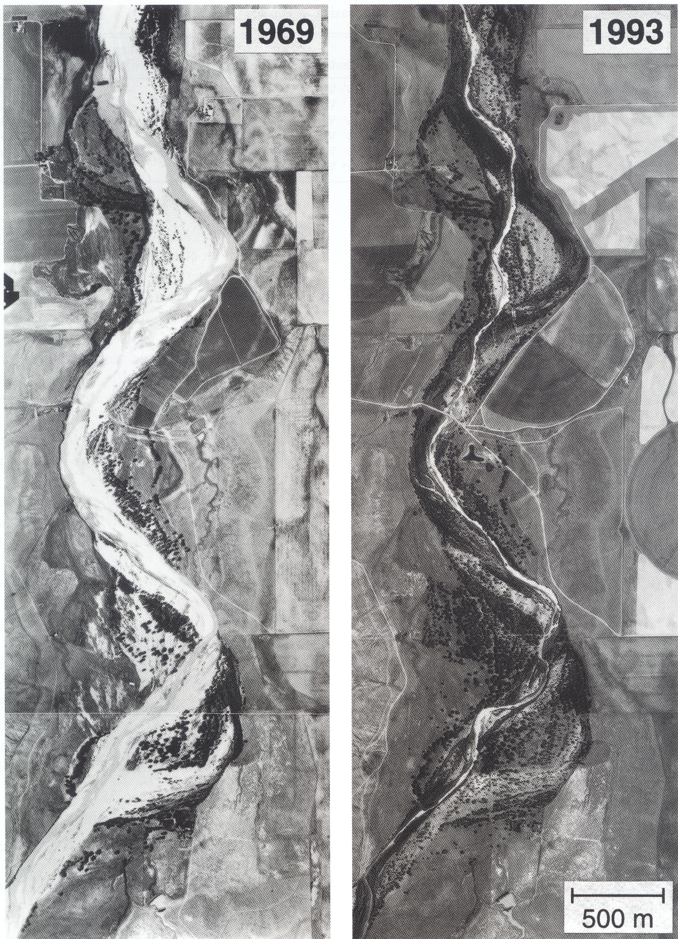
braided
meandering
Bijou Creek, USA: time

Slide 8
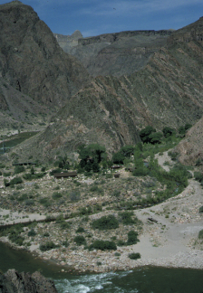
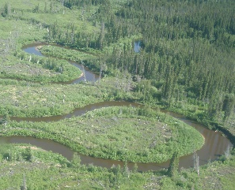
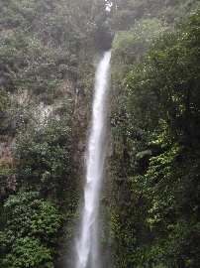
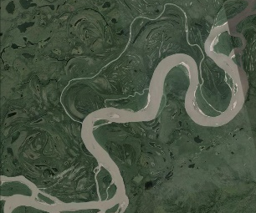
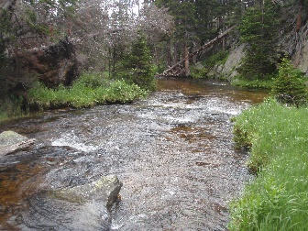
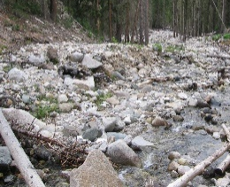
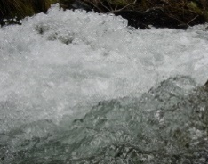
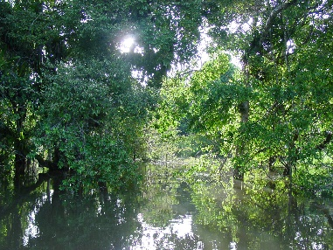
Valley Context
Q
natural flow (Q),
sediment (Q_{s})
& large wood (LW)
regimes
valley
geometry
&
human
influence
Q_{s}
LW
time
inputs
spatial limits on heterogeneity & connectivity
resulting spatial heterogeneity in river geometry & connectivity
expressed in the form of spatial variations in channel & floodplain
cross-sectional
geometry
floodplain
wetlands
gradient
planform
substrate, hydraulics

Slide 9
A natural sediment regime = conditions prior to construction of dams & intensive human disturbance of topography & land cover
Fundamental benchmark for a natural sediment regime:
patterns of ecosystem organization & adaptations of riverine species reflect the spatial pattern & temporal variability of interacting water & sediment regimes

Slide 10
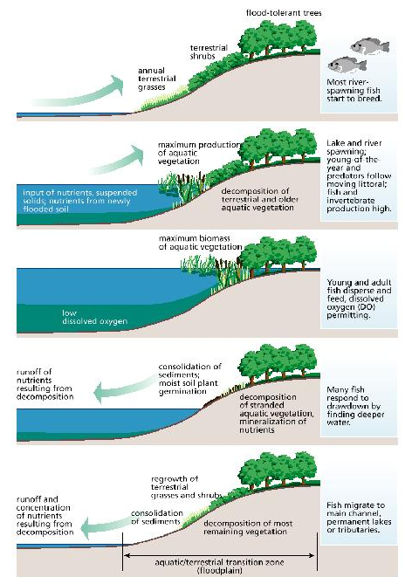
Flood-pulse model for lowland floodplain rivers
Flow-pulse model for braided rivers
low
flow
mean
flow
flood
flow
Tagliamento River, Italy
Bayley et al., 1995, BioScience
Tockner et al., 2000, Hydrological Processes

Slide 11

II. How do people alter sediment regimes?
Changes in
flow regime (magnitude, timing, duration)
sediment budget
large wood regime (abundance, distribution)
valley context (channel geometry, connectivity)
Resulting from
land use (land cover, topography)
flow regulation (dams, diversions)
channel engineering
(channelization, bank stabilization, levees, instream mining)

Slide 12
Example of land use change: urbanization
↓ sediment inputs
↑ water inputs (magnitude, rate of response)
↑ contaminants, ↓ organic matter
Stream response
coarsening of bed sediment
bed & bank erosion
increased flood hazard
reduced water quality
reduced biomass & biodiversity
Notes:
Add photos

Slide 13
Example of flow regulation: dam
↓ downstream sediment flux
∆ flow regime (magnitude, duration, timing, rate of change)
Stream response
coarsening of bed sediment
bed & bank erosion
increased flood hazard
reduced water quality
reduced biomass & biodiversity
Notes:
Add photos

Slide 14

III. What are the consequences of
altered sediment regimes?
Physical: altered channel geometry
Chemical: altered water quality (turbidity, nutrients, heavy metals)
Ecological
declines in habitat (abundance, diversity, stability)
reduced connectivity (channel-floodplain, surface-subsurface)
reduced biodiversity & abundance
Hazards
decreased channel stability (lateral migration, erosion/
aggradation, flooding)
altered downstream fluxes of sediment

Slide 15
+ sediment
- sediment
Physical
Δ bed grain size
+ bed grain size
Δ bedforms
(type, dimension, mobility)
Δ bedforms
(type, dimension, mobility)
aggradation
bank erosion
Δ planform
Δ gradient
incision
floodplain aggradation
Δ planform
Δ gradient
floodplain erosion
Δ habitat, thermal regime
& disturbance regime
Wohl et al., 2015, BioScience

Slide 16
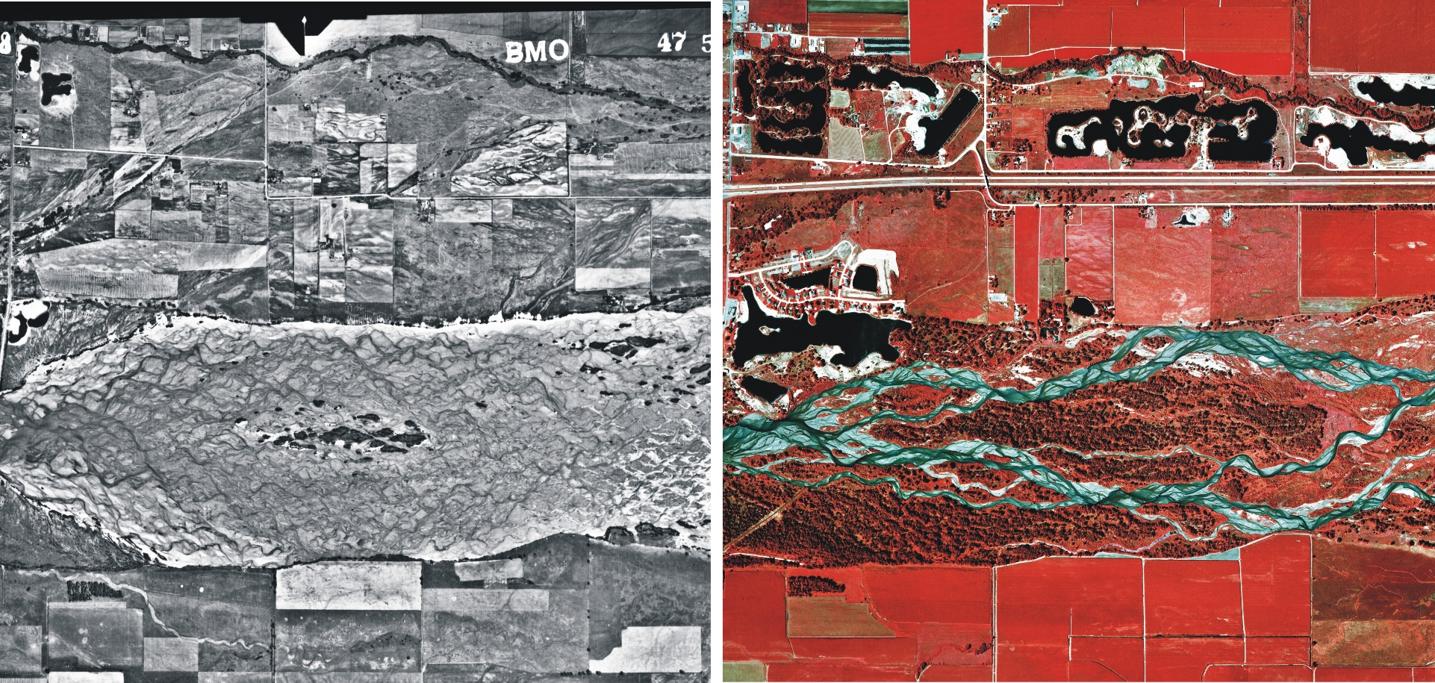
Case study
flow regulation & rivers of the US Great Plains
braided
1938
anastomosing
1988
Platte River near Kearney, Nebraska
substantial increase in riparian vegetation (darker gray color) & channel narrowing
habitat loss: endangered fish & bird species

Slide 17
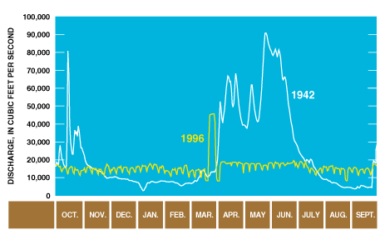
Case study
dams & the Colorado River ecosystem
pre-dam hydrograph
experimental flood
post-dam hydrograph

Slide 18
Negative effects of dam
eliminates downstream sediment flux
(importance of tributaries)
alters flow hydrograph
(magnitude & duration of peak, rate change)
changes water thermal regime
(bottom release = cold water)
eliminates longitudinal fish migration & limits use of
floodplain habitat
alters channel-margin habitat
(riparian zone, backwaters)
limits recreational camping sites

Slide 19
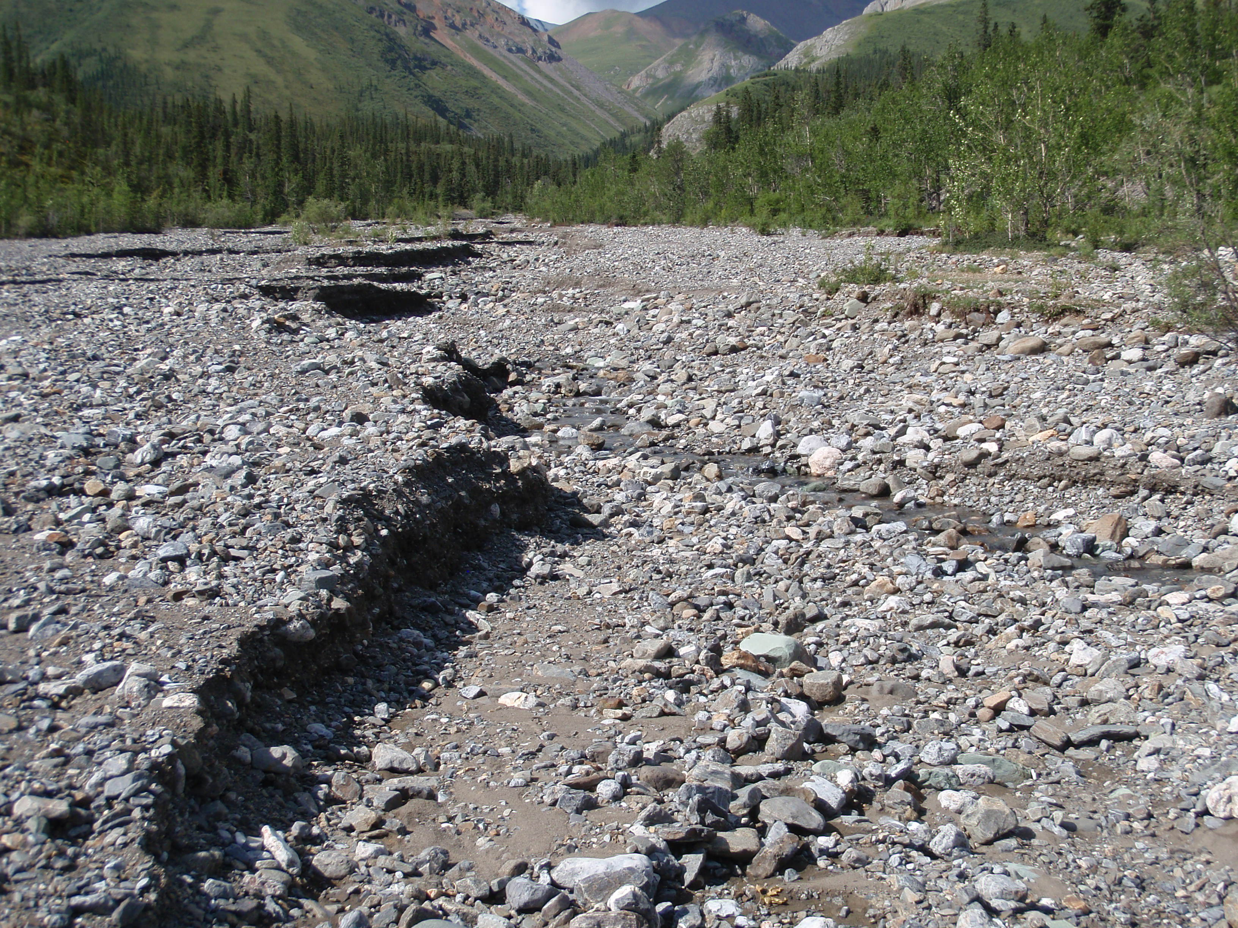
IV. How can a balanced sediment regime
be designed?
A balanced sediment regime = the energy of flow available to transport sediment is in balance with sediment supply:
River form remains dynamically stable over a specified time period.
In a management context, a balanced sediment regime is one that results in a channel that transports the sediment supplied to it with the available flow.

Slide 20
Key management questions:
What are the supplies of water and sediment?
What river system structure & function can be achieved under a modified flow regime and balanced sediment regime?

Slide 21

Potential metrics for assessing sediment dynamics
1. Sediment flux
suspended sediment (concentration, grain-size distribution)
bed-material sediment (volume per unit time, grain size)
reservoir sedimentation
sediment balance via CSR or S*
Capacity Supply Ratio (CSR) (Soar & Thorne, 2001)
CSR > 1 erosion
CSR < 1 aggradation

Slide 22
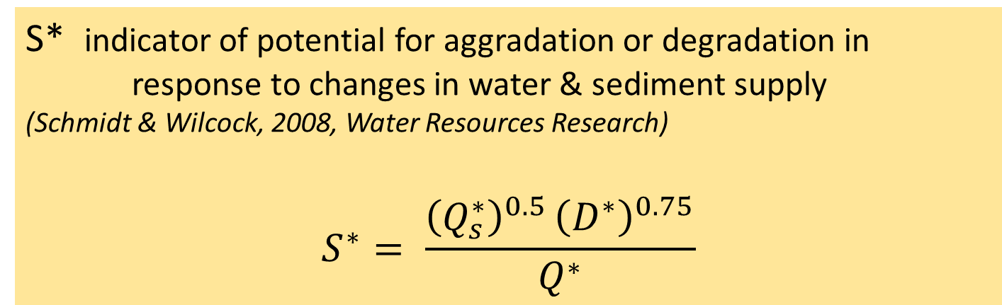

S* indicator of potential for aggradation or degradation in response to changes in water & sediment supply
(Schmidt & Wilcock, 2008, Water Resources Research)
$$S^{∗}= \frac{{\left(Q_{s}^{∗}\right)}^{0.5 }{\left(D^{∗}\right)}^{0.75}}{Q^{∗}}$$
$Q_{s}^{∗}= \frac{Q_{S}post}{Q_{S}pre}$, $D^{∗ }=\frac{Dpost}{Dpre}$, ${ Q}^{∗}=\frac{Qpost}{Qpre}$
sediment grain discharge
supply size
S = slope needed to transport sediment supplied
S* > 1 means increase in S needed to transport post-dam
sediment supply for specified change in flow
S* < 1 means pre-dam S is larger than now needed &
sediment deficit is predicted

Slide 23
Potential metrics for assessing sediment dynamics
2. Channel geometry
cross-sectional channel geometry (width, depth, bedform type &
dimensions, bank stability, pool volume)
bars & islands (number & successional stages)
bed substrate (grain size distribution, particle stability)
channel planform (sinuosity, number of channels)
floodplain (extent, turnover time, habitat diversity)
3. Vegetation patterns
spatial heterogeneity of species & plant ages

Slide 24
V. Moving Forward
Current understanding & tools allow us to predict the trajectories of river change in response to changes in sediment regime.
Measures of sediment balance can be used to determine whether the relative sediment supply is increasing or decreasing within a river segment & to assess the magnitude of change.

Slide 25
These variables can also be used to design management that creates a balanced sediment regime & facilitates channel stability.
A channel in dynamic equilibrium may not necessarily create the desired river system structure & function required to support native biota – channel stability in itself may not always be a sufficient management goal.

Slide 26
An understanding of sediment regime can be used to manage for a dynamically stable channel in which water and sediment interact to create the habitat & disturbance regime needed to support river biota.
With the tools and understanding currently available, there is no justification for managing river systems without explicitly considering sediment regime & every incentive to do so.

